Slide 1
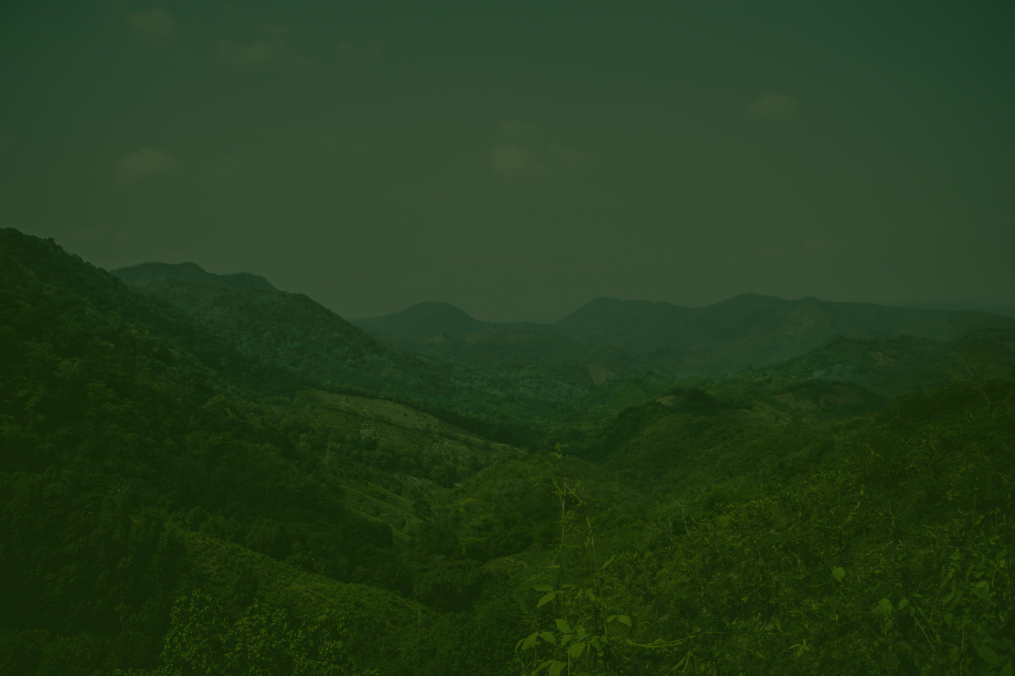

TITLE: PATTERN RECOGNITION AND REMOTE SENSING TECHNIQUES APPLIED TO LAND USE AND LAND COVER MAPPING IN THE BRAZILIAN SAVANNAH
LAND USE AND LAND COVER ANALYSIS

Slide 2

AUTHORS:
Leila M.G. Fonseca
Thales S. Körting
Hugo do N. Bendini
Cesare D. Girolamo-Neto

Slide 3

INTRODUCTION
Description Here
Title: Brazilian Savannah: Land Use Mapping
Brief: The Cerrado biome, covering 2 million km², crucial for biodiversity and development in Brazil.

Slide 4
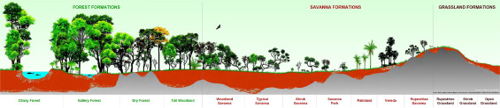
Rimberio Co
Importance of Cerrado
Stores 5.9 billion tons of carbon in vegetation and 23.8 billion tons in soil.
Challenges: Preserve Cerrado amidst agricultural expansion.

Slide 5
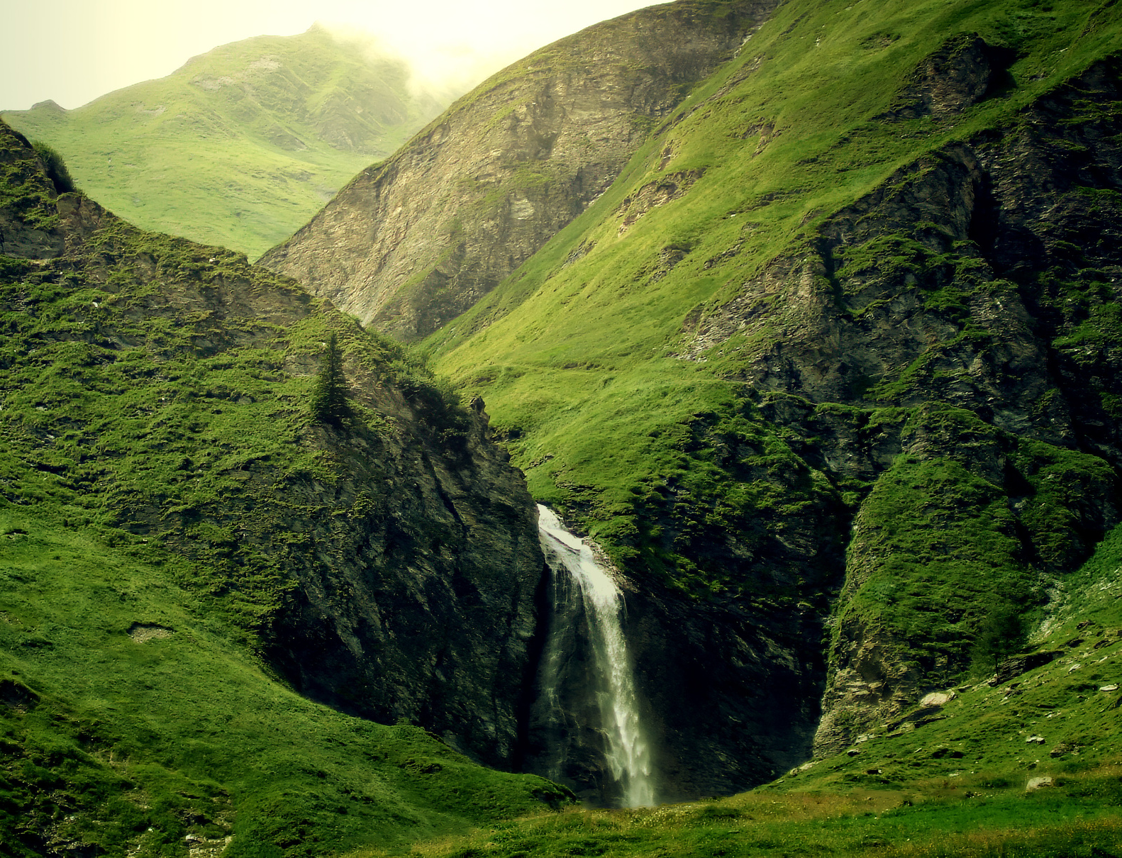
LAND USE CHALLENGES
Over 50% loss of natural vegetation.
Projection: 31-34% more cleared by 2050.
Importance of Land Use and Land Cover (LULC) mapping.

Slide 6
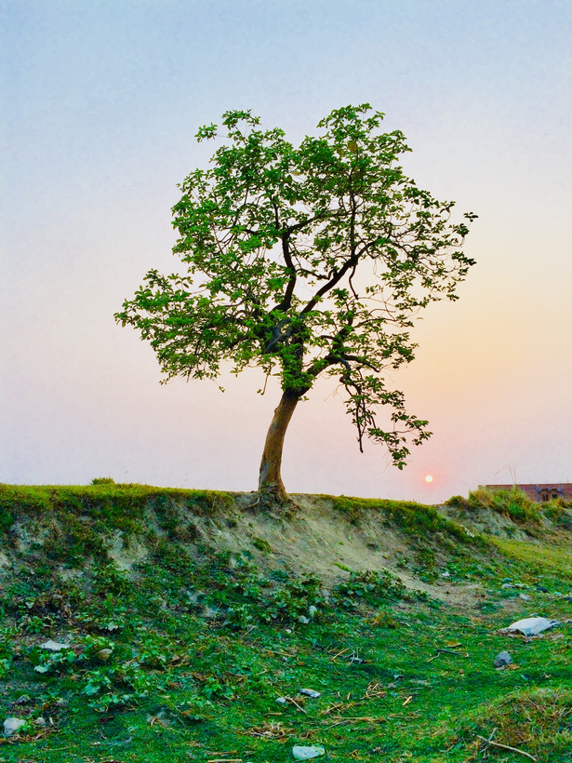
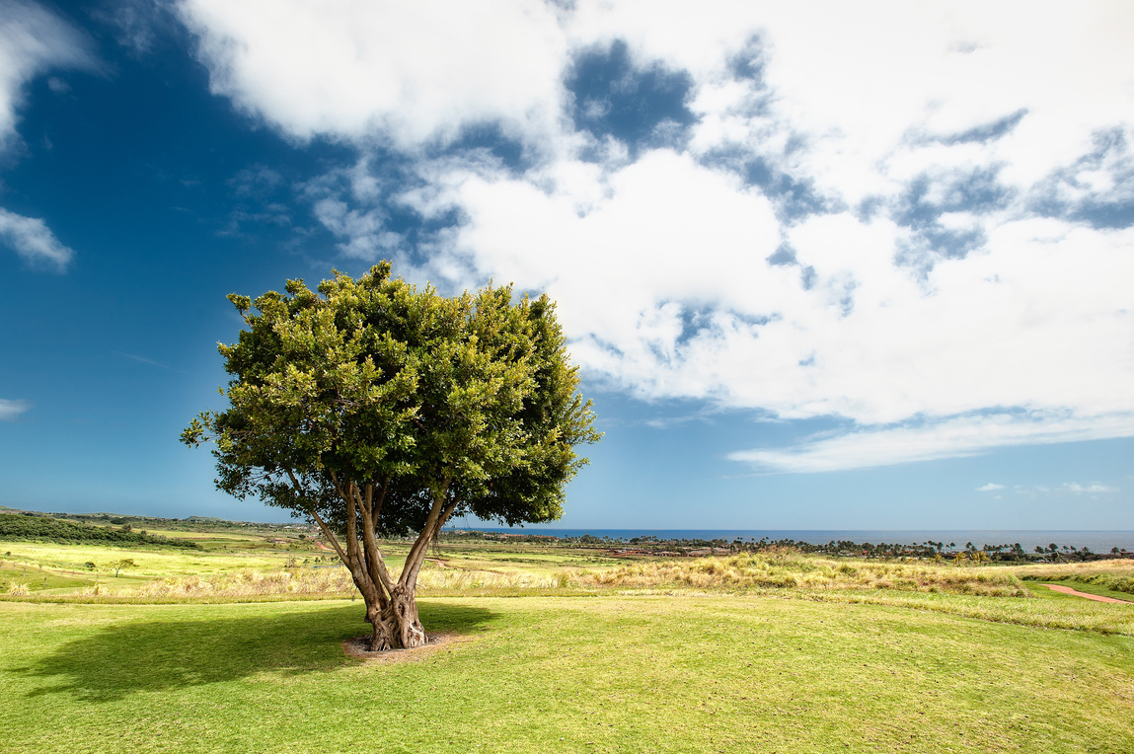
REMOTE SENSING TECHNOLOGIES
TerraClass and MapBiomas projects.
Contributions to environmental monitoring.
Need for detailed LULC maps.

Slide 7

MAPPING NATURAL VEGETATION
Challenges: High spatial variability, spectral similarity.
Methods: Supervised, non-supervised classification, object-based methods.
Advances: Open RS technologies, Sentinel, CBERS, and machine learning.

Slide 8
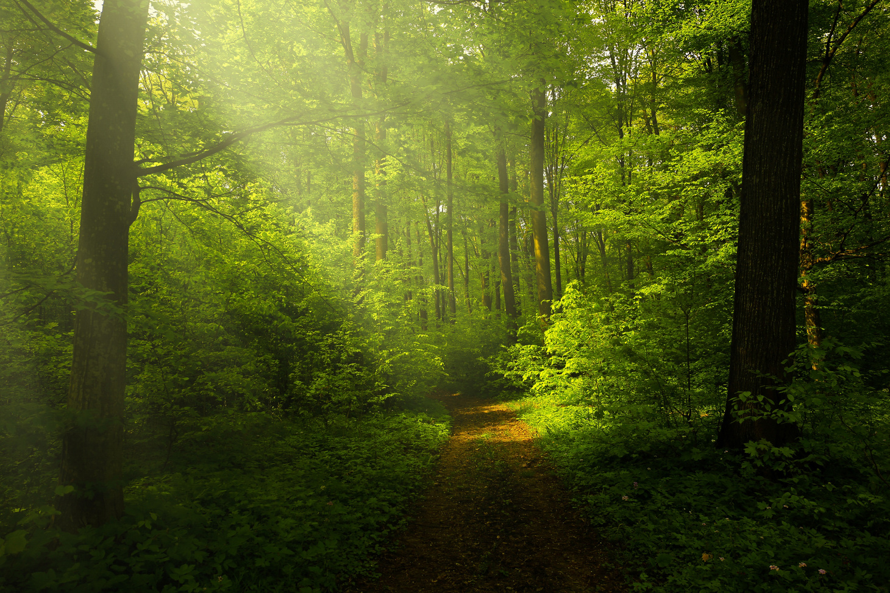
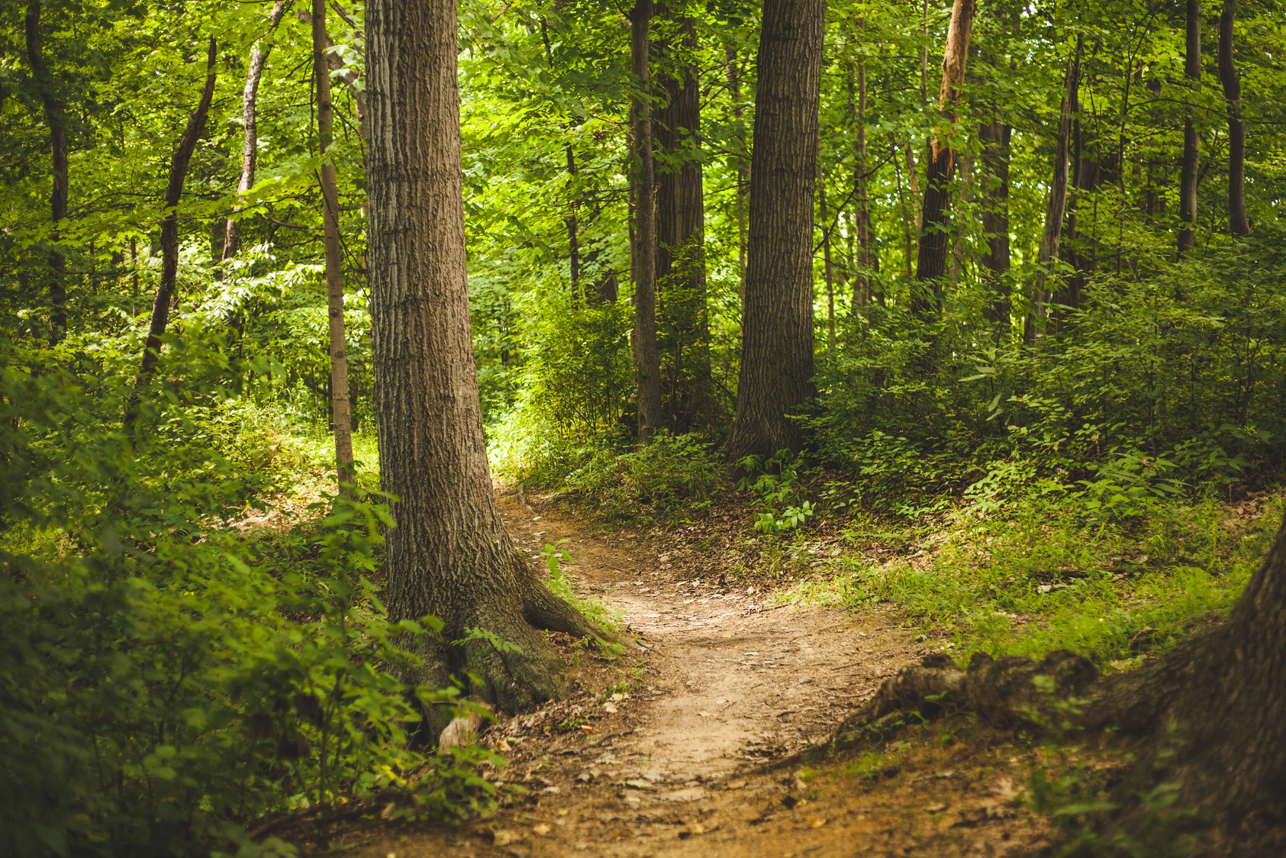
MAPPING PASTURELAND
Over 50,000 km² converted in recent years.
Challenges in automatic methods.
Utilization of time series and GEOBIA techniques.

Slide 9
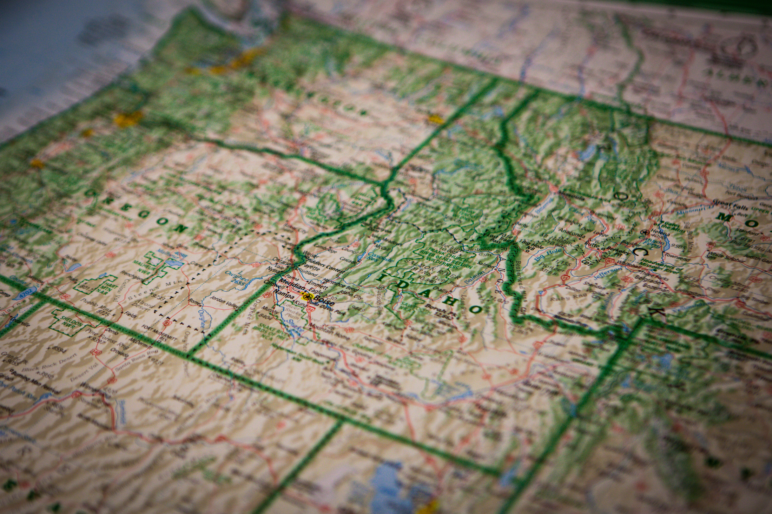

MAPPING AGRICULTURE
Paradox of conservation and development.
Use of RS data for detailed agricultural mapping.
Integration of different sensors for improved accuracy.

Slide 10
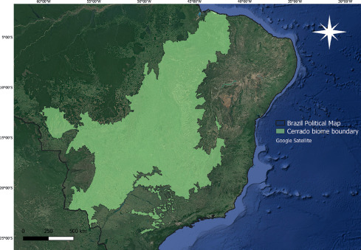
MAPPING DEFORESTATION
PRODES and DETER methodologies.
Automation initiatives: GLAD, SAD, SIAD.
Evaluation of deep learning techniques for deforestation detection.

Slide 11
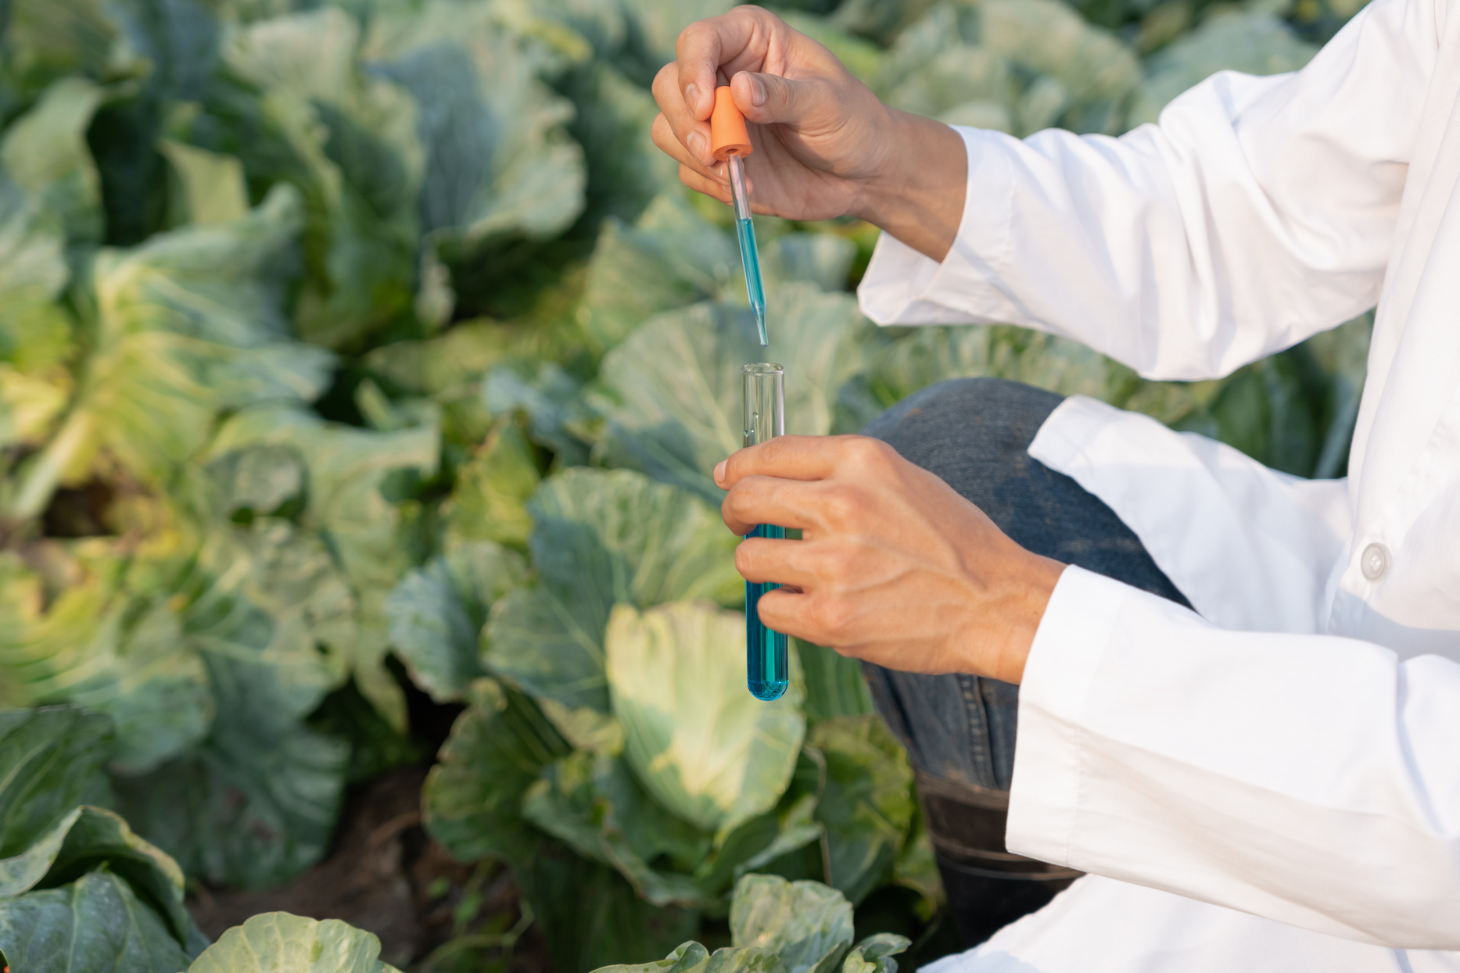
REVIEW FINDINGS
Highlights: Phenological metrics, hierarchical classification.
Contextual information importance.
Potential with Synthetic Aperture Radar (SAR) and LIDAR GEDI data.

Slide 12
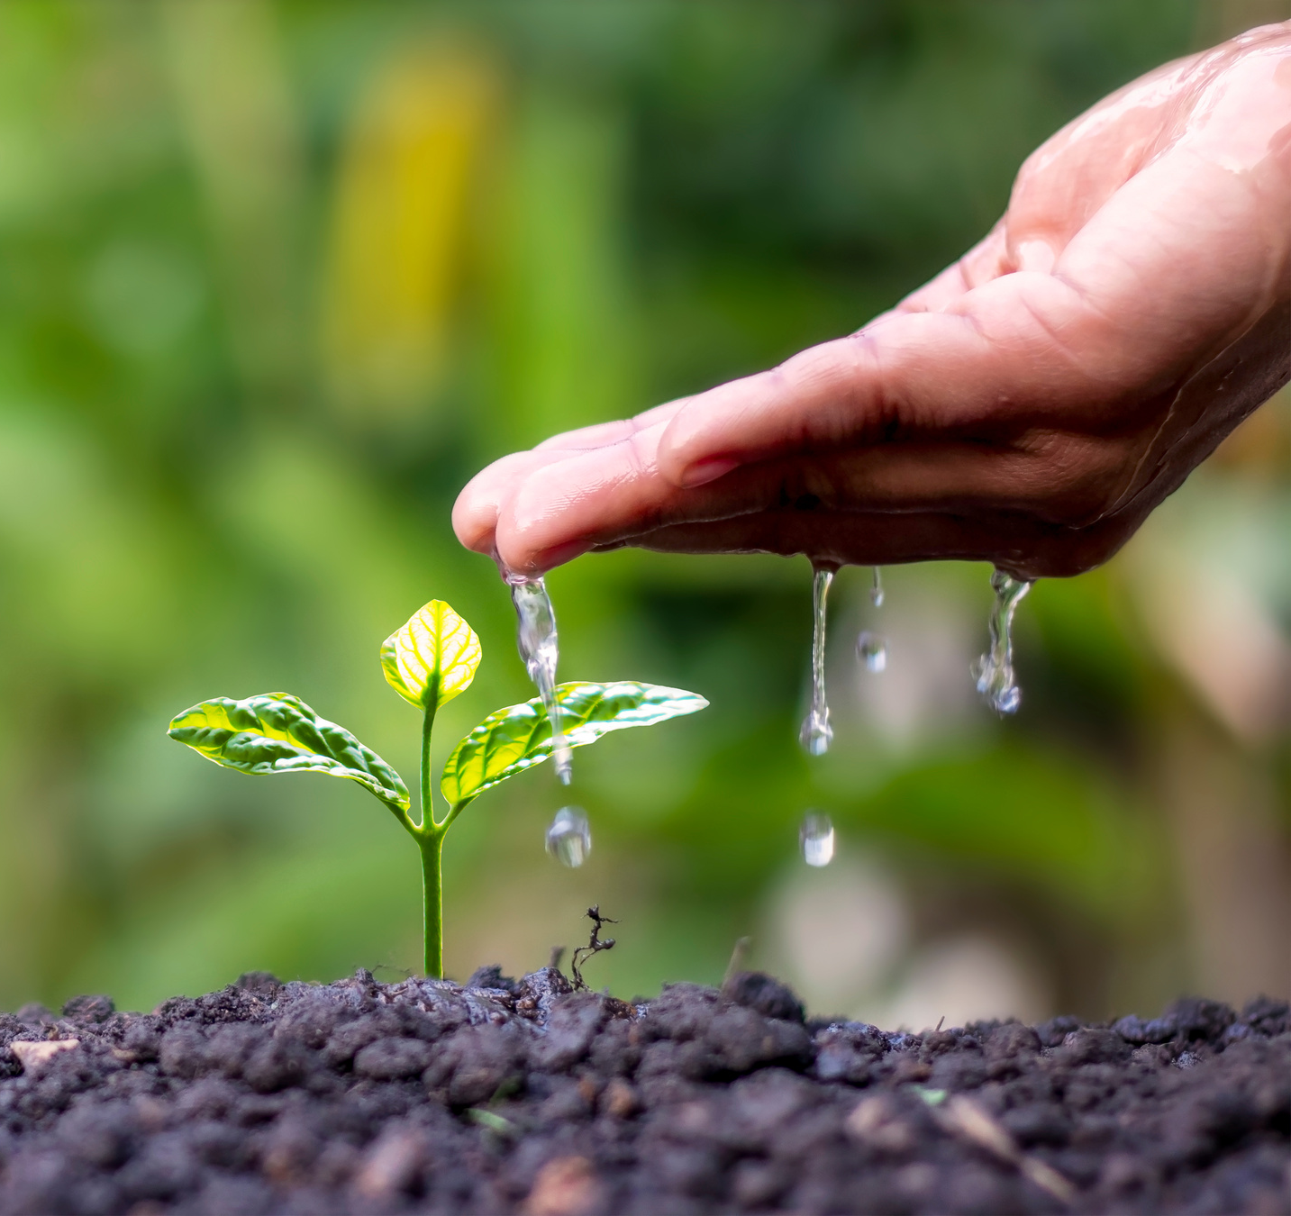
CONCLUSION AND FUTURE DIRECTIONS
Summary: Identified challenges and advancements.
Future Directions: Earth Observation Data Cubes, integration of spatial and temporal information.

Slide 13

THANK YOU
OPEN FLOOR FOR QUESTIONS AND DISCUSSIONS.

